Slide 1
DS3202: PARALLEL PROGRAMMING
MODULE – 4
Introduction to Data Parallelism with CUDA
6th SEM
B.Tech
DSE

Slide 2
Many Core Systems: Heterogeneous Parallel Computing
Heterogeneous Multicore Processors
Heterogeneous cores are not identical.
They can differ in capabilities, speed, may lack certain features or otherwise perform a task differently.
Heterogeneous computing typically refers to a system that uses multiple types of computing cores, like CPUs, GPUs, ASICs, FPGAs, and NPUs. (Application Specific Integrated Circuit Core, Field Programmable Gate Array (semiconductor integrated),Neural Processing Units).
By assigning different workloads to processors that are designed for specific purposes or specialized processing, performance and energy efficiency is improved.

Slide 3
The term “heterogenous compute” may also refer to the use of processors based on different computer architectures, a common approach when a particular architecture is better suited for a specific task due to power efficiency, compatibility, or the number of cores available.
An early and still relatively common form of heterogenous computing is the combination of CPU cores and a GPU (Graphics Processing Unit), used for gaming and other graphics-rich applications.

Slide 4
Heterogeneous computing enables a single system to have multiple computing sub-systems.
Advantages:
These processors, which may execute core instructions differently, work in parallel to
Accelerate compute speed and
Minimize the time required to complete a task.
Applications:
This is particularly useful in the development of Artificial Intelligence (AI) and Machine Learning (ML) workloads, where vast amounts of data must be processed and converted for a seamless user experience.

Slide 5
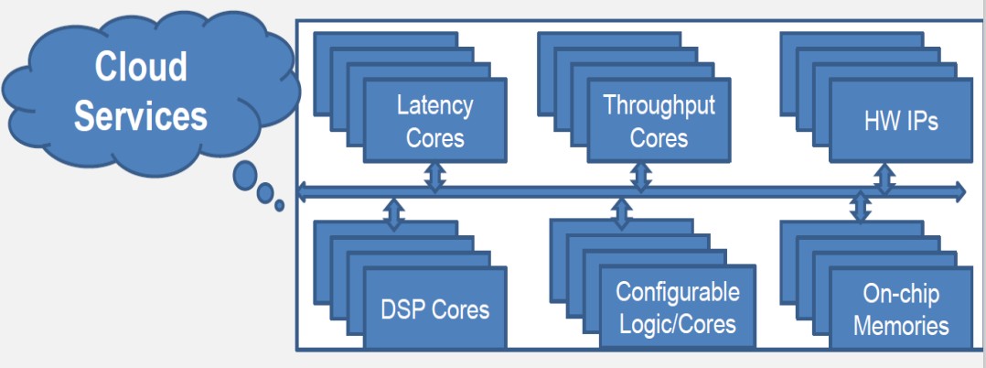
Heterogenous Parallel Computing – Example

Slide 6
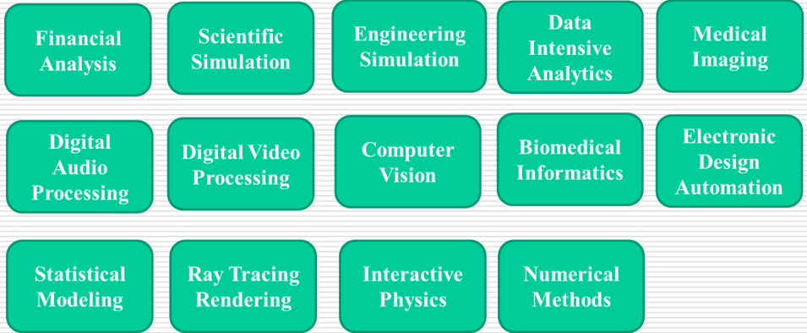
Uses of Heterogenous Parallel Computing

Slide 7
Introduction to Data Parallelism
Data parallelism is a parallel computing paradigm in which a large task is divided into smaller, independent, simultaneously processed subtasks.
Via this approach, different processors or computing units perform the same operation on multiple pieces of data at the same time.
Data Parallelism means concurrent execution of the same task on each multiple computing core.
Same task are performed on different subsets of same data.
The primary goal of data parallelism is to:
Improve computational efficiency
Speed

Slide 8
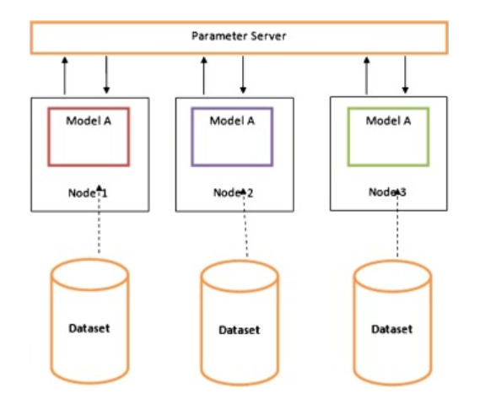
Example 1:

Slide 9
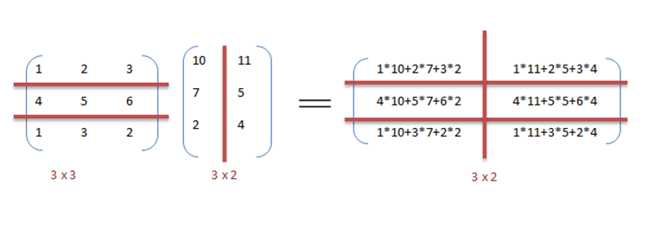
Example 2: Data parallelism in matrix multiplication

Slide 10
How Does Data Parallelism Work?
Data parallelism works by:
Dividing data into chunks
The first step in data parallelism is breaking down a large data set into smaller, manageable chunks.
This division can be based on various criteria, such as dividing rows of a matrix or segments of an array.
Distributed processing
Once the data is divided into chunks, each chunk is assigned to a separate processor or thread.
This distribution allows for parallel processing, with each processor independently working on its allocated portion of the data.

Slide 11
Simultaneous processing
Multiple processors or threads work on their respective chunks simultaneously.
This simultaneous processing enables a significant reduction in the overall computation time, as different portions of the data are processed concurrently.
Operation replication
The same operation or set of operations is applied to each chunk independently.
This ensures that the results are consistent across all processed chunks.
Common operations include mathematical computations, transformations, or other tasks that can be parallelized.

Slide 12
Aggregation
After processing their chunks, the results are aggregated or combined to obtain the final output.
The aggregation step might involve summing, averaging, or otherwise combining the individual results from each processed chunk.

Slide 13
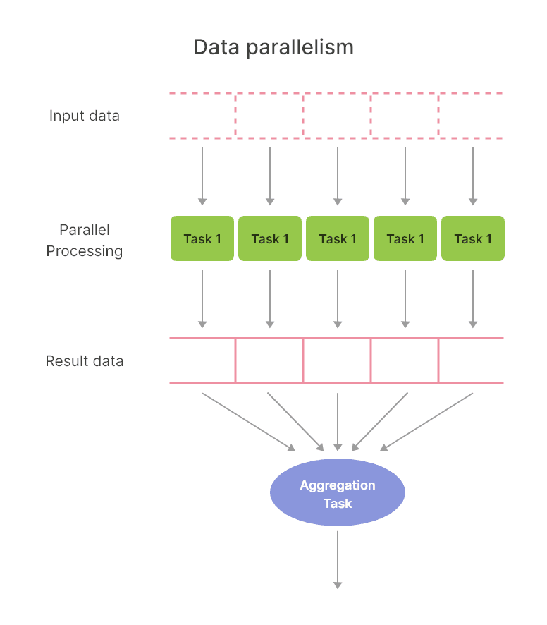

Slide 14
Benefits of Data Parallelism
Improved Performance
Data parallelism leads to a significant performance improvement by allowing multiple processors or threads to work on different chunks of data simultaneously. This parallel processing approach results in faster execution of computations compared to sequential processing.
Scalability
One of the major advantages of data parallelism is its scalability. As the size of the data set or the complexity of computations increases, data parallelism can scale easily by adding more processors or threads. This makes it well-suited for handling growing workloads without a proportional decrease in performance.

Slide 15
Efficient Resource Usage
By distributing the workload across multiple processors or threads, data parallelism enables efficient use of available resources. This ensures that computing resources, such as CPU cores or GPUs, are fully engaged, leading to better overall system efficiency.
Handling Large Data Sets
Data parallelism is particularly effective in addressing the challenges posed by large data sets. By dividing the data set into smaller chunks, each processor can independently process its portion, enabling the system to handle massive amounts of data in a more manageable and efficient manner.
Improved Throughput
Data parallelism enhances system throughput by parallelizing the execution of identical operations on different data chunks. This results in a higher throughput as multiple tasks are processed simultaneously, reducing the overall time required to complete the computations.

Slide 16
Fault Tolerance
In distributed computing environments, data parallelism can contribute to fault tolerance. If one processor or thread encounters an error or failure, the impact is limited to the specific chunk of data it was processing, and other processors can continue their work independently.
Versatility across Domains
Data parallelism is versatile and applicable across various domains, including scientific research, data analysis, artificial intelligence, and simulation. Its adaptability makes it a valuable approach for a wide range of applications.

Slide 17
Data Parallelism Real-world Applications
Machine Learning
Image and Video Processing
Genomic Data Analysis
Financial Analytics
Climate Modeling
Computer Graphics

Slide 18
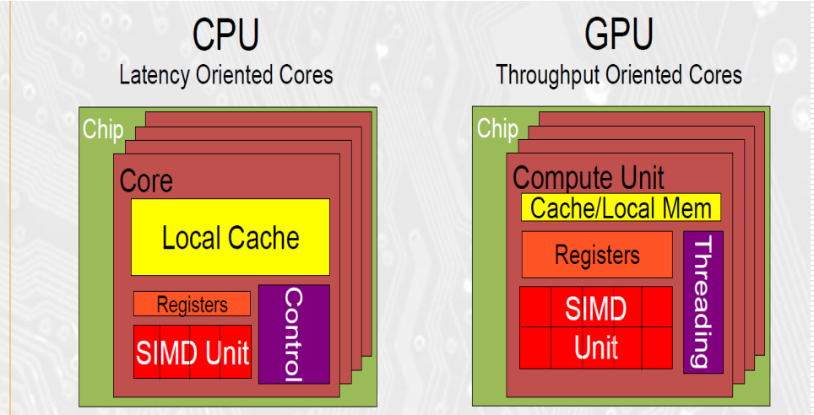
CPU and GPU Design Philosophy

Slide 19
Latency vs Throughput oriented architecture
Latency Oriented Architecture | Throughput Oriented Architecture
Focuses on minimizing the time it takes to complete individual tasks or instructions. | Priority is maximizing the total number of operations completed within a given timeframe.
Reduced latency of cache accesses, minimized branch mispredictions, and prioritizing the execution of critical path instruction. | While individual operations may have higher latency compared to CPUs, GPUs excel at processing large volumes of data in parallel, resulting in high overall throughput.
Well-suited for tasks that require low response times and are not easily parallelizable. | Well-suited for highly parallelizable tasks such as graphics rendering, scientific simulations, and deep learning training.
E.g- general-purpose computing tasks, gaming, and real-time processing applications. | E.g- GPU's that achieve high throughput by exploiting thread-level and data-level parallelism across thousands of processing cores.

Slide 20
CPU(Central Processing Unit)
A CPU, or central processing unit, is a hardware component that is the core computational unit in a server.
It handles all types of computing tasks required for the operating system and applications to run correctly.
Constructed from billions of transistors, can have multiple processing cores and is commonly referred to as the “brain” of the computer.
It is essential to all modern computing systems, as it executes the commands and processes needed for your computer and operating system.
Latency oriented processor architecture is the microarchitecture of a microprocessor designed to serve a serial computing thread with a low latency.

Slide 21
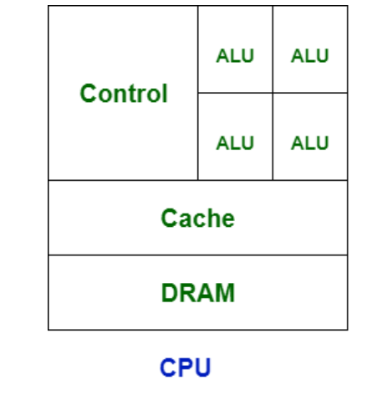

Slide 22
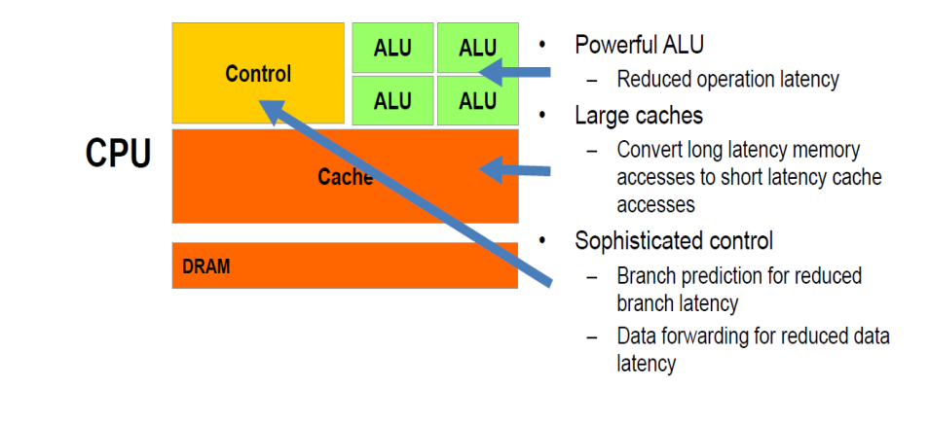

Slide 23
CPU comprises the arithmetic logic unit (ALU) accustomed quickly to store the information and perform calculations and
Control Unit (CU) for performing instruction sequencing as well as branching.
CPU interacts with more computer components such as memory, input and output for performing instruction.

Slide 24
GPU (Graphics Processing Unit)
A graphics processing unit (GPU) is a similar hardware component like CPU, but more specialized.
A GPU supports the CPU to perform concurrent calculations.
The main difference between CPU and GPU architecture is that a CPU is designed to handle a wide-range of tasks quickly (as measured by CPU clock speed), but are limited in the concurrency of tasks that can be running.
A GPU can complete simple and repetitive tasks much faster because it can break the task down into smaller components and finish them in parallel.
A GPU is designed to quickly render high-resolution images and video concurrently.

Slide 25
It can more efficiently handle complex mathematical operations that run in parallel than a general CPU.
While GPUs were initially created to handle graphics and hyper-realistic gaming visuals , they have evolved to become more general-purpose parallel processors as well, handling a growing range of applications, including AI.
The GPU is a processor that is made up of many smaller and more specialized cores.
By working together, the cores deliver massive performance when a processing task can be divided up across many cores at the same time.
It contains more ALU units than CPU.
GPU is faster than CPU’s speed and it emphasis on high throughput.
Throughput oriented architectures, usually have a multitude of processors with much smaller caches and simpler control logic. This helps to efficiently utilize the memory bandwidth and increase the total number of execution units on the same chip area.

Slide 26
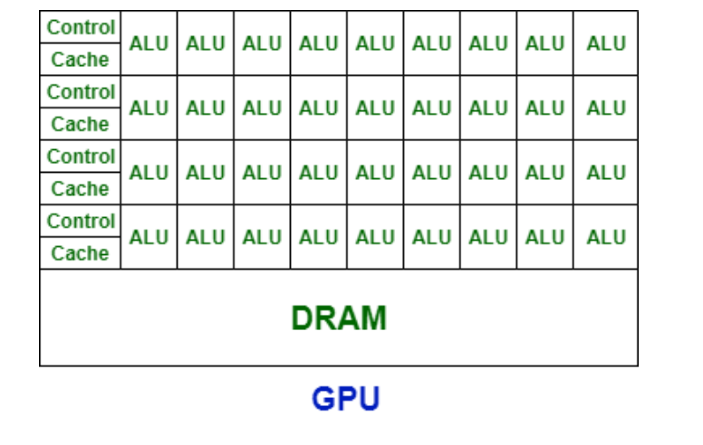

Slide 27
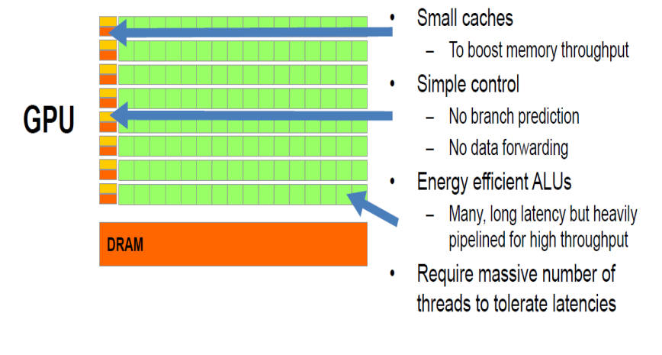

Slide 28
Similarity between CPU and GPU
CPUs and GPUs have a lot in common.
Both are critical computing engines.
Both are silicon-based microprocessors.
And both handle data.
But CPUs and GPUs have different architectures and are built for different purposes.

Slide 29
When to use GPUs over CPUs
Every server or server instance in the cloud requires a CPU to run.
However, some servers also include GPUs as additional coprocessors.
Specific workloads are better suited to run on servers with GPUs that perform certain functions more efficiently.
For example, GPUs can be great for complex mathematical calculations, graphics processing, or data pattern matching.
CPU has limited number of cores and can run limited number of threads simultaneously.
In graphics, many pixels are processed simultaneously so we need many threads executing simultaneously. Hence, we need GPU which have more number of cores.
Nvidia's GPU GeForce GTX TITAN X consists of 3072 cores.

Slide 30
CPU/GPU Combination
In some cases, shared graphics are built right onto the same chip as the CPU.
These CPUs include a GPU instead of relying on dedicated or discrete graphics.
These are processors with built-in graphics and offer many benefits.
CPU/GPUs deliver space, cost, and energy efficiency benefits over dedicated graphics processors.
They provide the horsepower to handle processing of graphics-related data and instructions for common tasks.
Processors with built-in graphics are a great choice for immersive gaming, 4K streaming, video editing, and exploring the web with lightning-fast connectivity.
Processors with built-in graphics are most often used in devices where compact size and energy efficiency are important, such as laptops, tablets, smartphones, and some desktops.

Slide 31
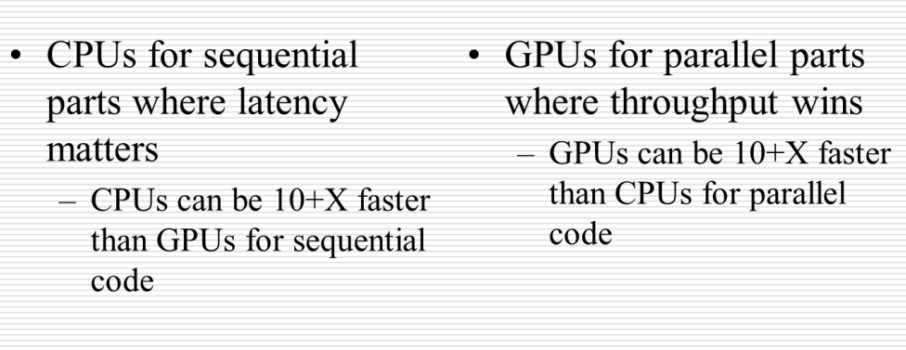
Winning applications use both CPU and GPU

Slide 32
Analogy for CPU and GPU
To understand better, consider the following analogy.
The CPU is like a head chef in a large restaurant who has to make sure hundreds of burgers get flipped.
Even if the head chef can do it personally, it’s not the best use of time.
All kitchen operations may halt or slow down while the head chef is completing this simple but time-consuming task.
To avoid this, the head chef can use junior assistants who flip several burgers in parallel.
The GPU is more like a junior assistant with ten hands who can flip 100 burgers in 10 seconds.

Slide 33
Applications of GPU
Deep learning
High-performance computing
Autonomous vehicles

Slide 34
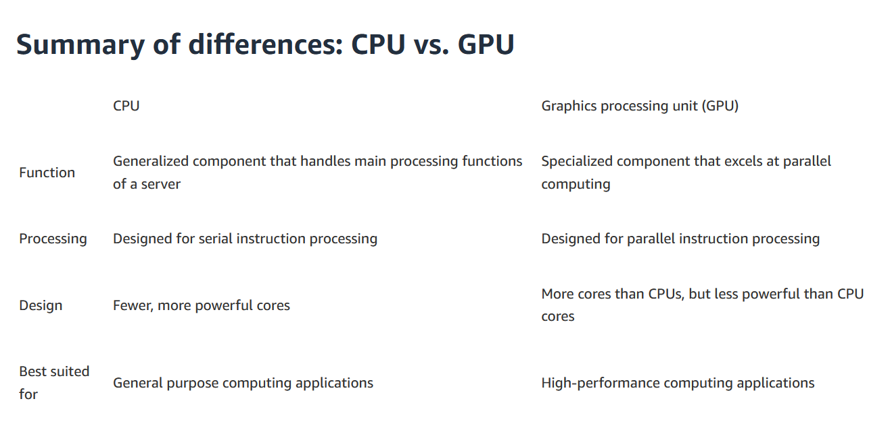

Slide 35
CPUs prove inefficient to operate on large chunks of data
GPUs focus on execution throughput of massively-parallel programs.

Slide 36
CUDA – Data Parallelism in GPU (Introduction)
CUDA (Compute Unified Device Architecture) is a parallel computing platform and application programming interface (API), or programming model developed by NVIDIA for general computing on graphical processing units (GPUs).
With CUDA, developers are able to dramatically speed up computing applications by utilizing the power of GPUs.
CUDA is a software layer that gives direct access to the GPU's virtual instruction set and parallel computational elements for the execution of compute kernels.
This accessibility makes it easier for specialists in parallel programming to use GPU resources, in contrast to prior APIs like Direct3D and OpenGL, which required advanced skills in graphics programming.
CUDA allows us to use parallel computing for so-called general-purpose computing on graphics processing units (GPGPU)

Slide 37
CUDA technology enables parallel processing by breaking down a task into thousands of smaller "threads" executed independently.
CUDA is an extension of C programming.
CUDA is designed to work with programming languages such as C, C++, and Fortran.
CUDA-powered GPUs also support programming frameworks such as OpenMP, OpenACC and OpenCL and HIP by compiling such code to CUDA.

Slide 38
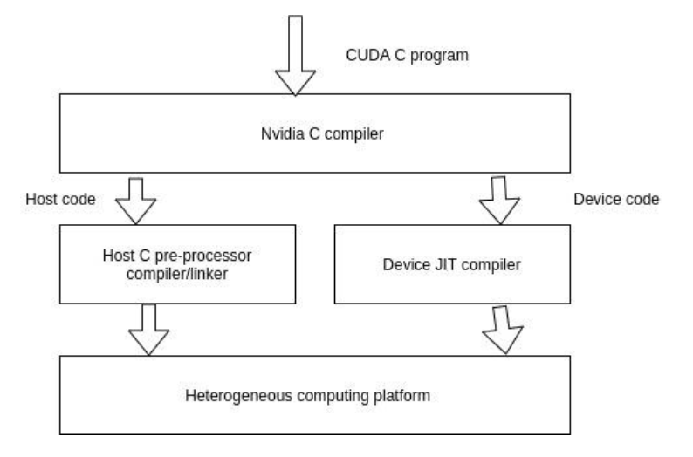
CUDA Program Structure

Slide 39
A typical CUDA program has code intended both for the GPU and the CPU.
Typically, we run serial workload on CPU and offload parallel computation to GPUs.
By default, a traditional C program is a CUDA program with only the host code.
The CPU is referred to as the host, and the GPU is referred to as the device.
The host code can be compiled by a traditional C compiler as the GCC, the device code needs a special compiler to understand the API functions that are used.
For Nvidia GPUs, the compiler is called the NVCC (Nvidia C Compiler).

Slide 40
The device code runs on the GPU, and the host code runs on the CPU.
The NVCC processes a CUDA program, and separates the host code from the device code.
To accomplish this, special CUDA keywords are looked for.
The code intended to run on the GPU (device code) is marked with special CUDA keywords for labelling data-parallel functions, called ‘Kernels’.
The device code is further compiled by the NVCC and executed on the GPU.

Slide 41
CPU and GPUs are separate entities.
Both have their own memory space.
CPU cannot directly access GPU memory, and vice versa.
In CUDA terminology, CPU memory is called host memory and GPU memory is called device memory.
Pointers to CPU and GPU memory are called host pointer and device pointer, respectively.
For data to be accessible by GPU, it must be presented in the device memory.
CUDA provides APIs for allocating device memory and data transfer between host and device memory.

Slide 42
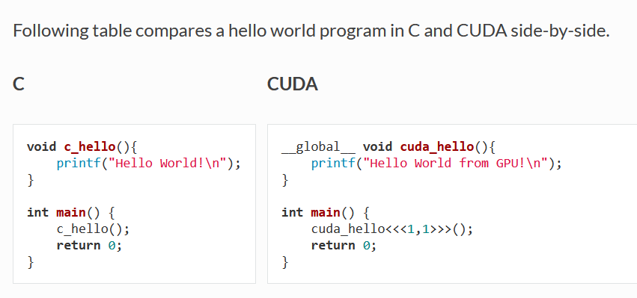
A quick comparison between CUDA and C

Slide 43
Explanation
The major difference between C and CUDA implementation is __global__ specifier (Kernel) and <<<...>>> syntax (kernel launch)
The __global__ specifier indicates a function that runs on device (GPU).
Such function can be called through host code, e.g. the main() function in the example, and is also known as "kernels".
Kernel: a C function which is flagged to be run on a GPU (or a device).
When a kernel is called, its execution configuration is provided through <<<...>>> syntax, e.g. cuda_hello<<<1,1>>>().
Triple angle brackets mark a call from host code to device code
Also called a “kernel launch” in CUDA terminology.
We will discuss about the parameter (1,1)

Slide 44
Parameter (1,1)
CUDA use a kernel execution configuration <<<...>>> to tell CUDA runtime how many threads to launch on GPU.
CUDA organizes threads into a group called "thread block".
Kernel can launch multiple thread blocks, organized into a "grid" structure.
The syntax of kernel execution configuration is as follows
<<< M , T >>>
which indicate that a kernel launches with a grid of M thread blocks.
Each thread block has T parallel threads.

Slide 45
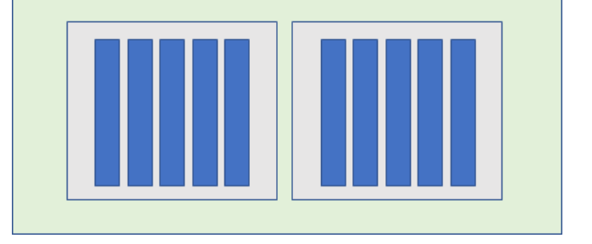
Example: <<< 2 , 5 >>>
In the drawing, each blue rectangle represents a thread.
Each grey rectangle represents a block.
The green rectangle represents the grid.

Slide 46
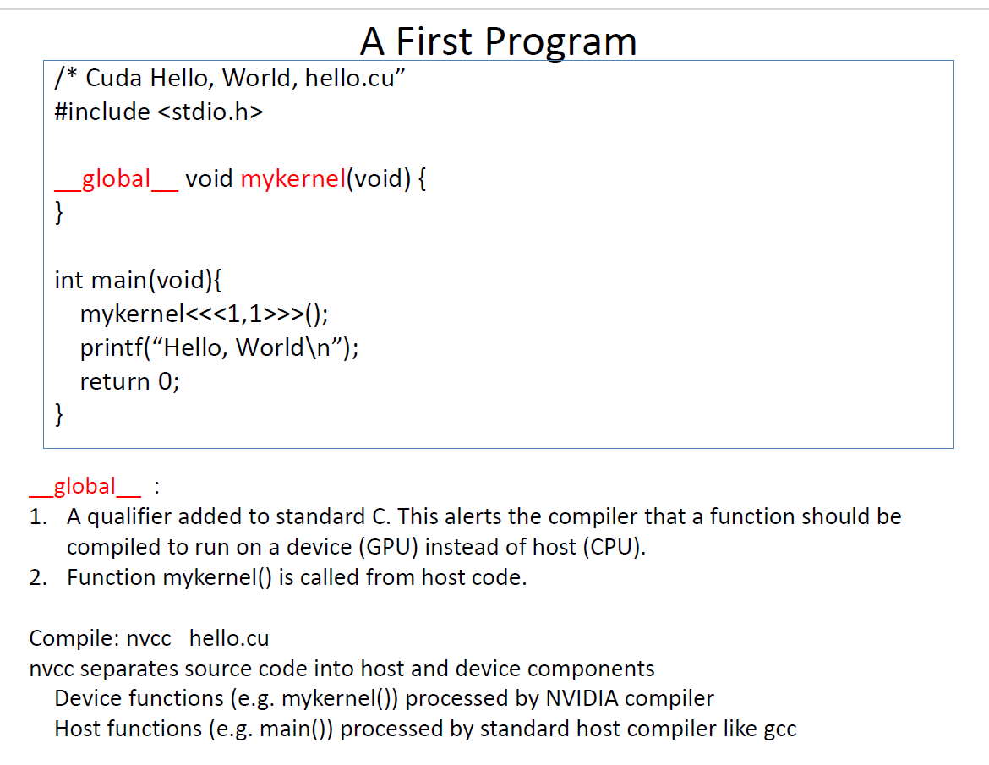

Slide 47
Try it Yourself
#include<stdio.h>
_global_ void hello()
{
printf(“Hello World from GPU\n”);
}
Int main()
{
hello<<<2,2>>>();
printf(“Hello World from CPU\n”);
return 0;
}

Slide 48
Basic Steps of Cuda Programming
Following is the common workflow of CUDA programs.
Allocate host memory and initialize host data
(ie Initialization of data on CPU)
Allocate device memory
Transfer input data from host to device memory
(ie Transfer data from CPU to GPU)
Kernel launch (instructions on GPU)
Execute kernels
Transfer output from device memory to host
(Transfer results back to CPU from GPU)
Reclaim the memory from both CPU and GPU

Slide 49
Device Global Memory and Data Transfer
Global memory can be considered the main memory space of the GPU in CUDA.
It is allocated, and managed, by the host, and it is accessible to both the host and the GPU with the help of CUDA API.
For this reason, the global memory space can be used to exchange data between the two.
Global memory resides on the device.
Obviously, every memory has a size limit.
The global memory is the total amount of DRAM of the GPU you are using.

Slide 50
A typical GPU comes with its own global memory (DRAM- Dynamic Random Access Memory).
In current CUDA systems, devices are often hardware cards that come with their own dynamic random-access memory called device global memory, or simply global memory.
For example, the Nvidia GTX 480 has DRAM size equal to 4GB and NVIDIA Volta V100 comes with 16GB or 32GB of global memory.
To execute a kernel on the GPU, the programmer needs to allocate separate memory on the GPU by writing code.
The CUDA API provides specific functions for accomplishing this.

Slide 51
The name global here refers to scope, as it can be accessed and modified from both the host and the device.
Global memory can be declared in global (variable) scope using
The __device__ declaration specifier as in the first line of the following code snippet
or
Dynamically allocated using cudaMalloc() and assigned to a regular C pointer variable as in line 7
Global memory allocations can persist for the lifetime of the application.
Depending on the compute capability of the device, global memory may or may not be cached on the chip.

Slide 52
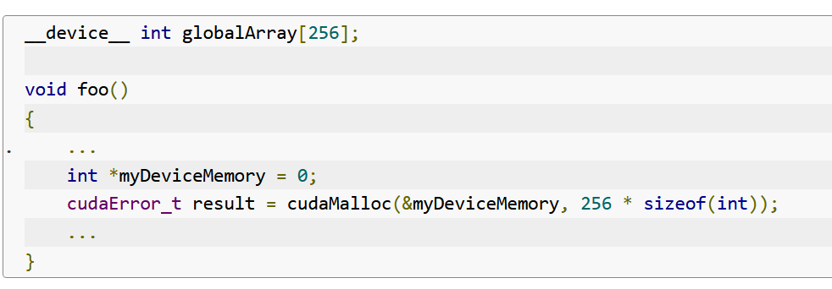

Slide 53
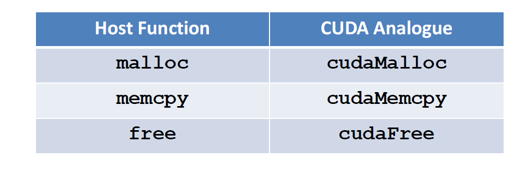
Device Functions

Slide 54
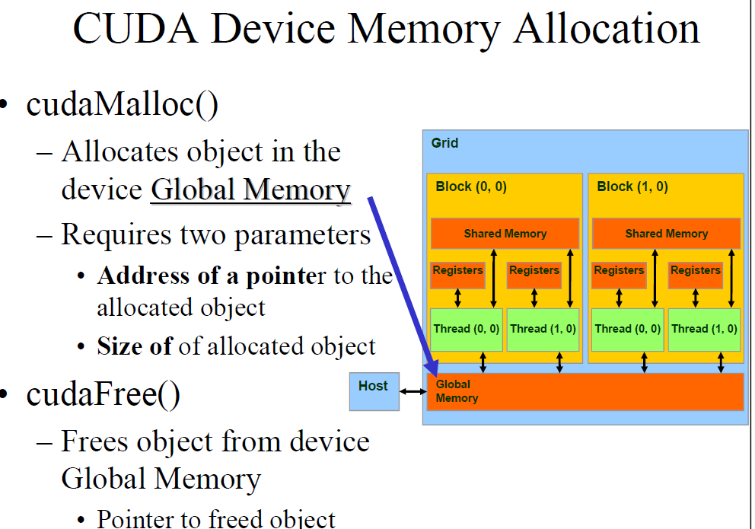

Slide 55
The cudaMalloc function can be called from the host code to allocate a piece of device global memory for an object.
Syntax of cudaMalloc
cudaMalloc((void**)&Md, size);
Here Md is the allocated storage of device
Syntax of cudaFree
cudaFree(Md);

Slide 56
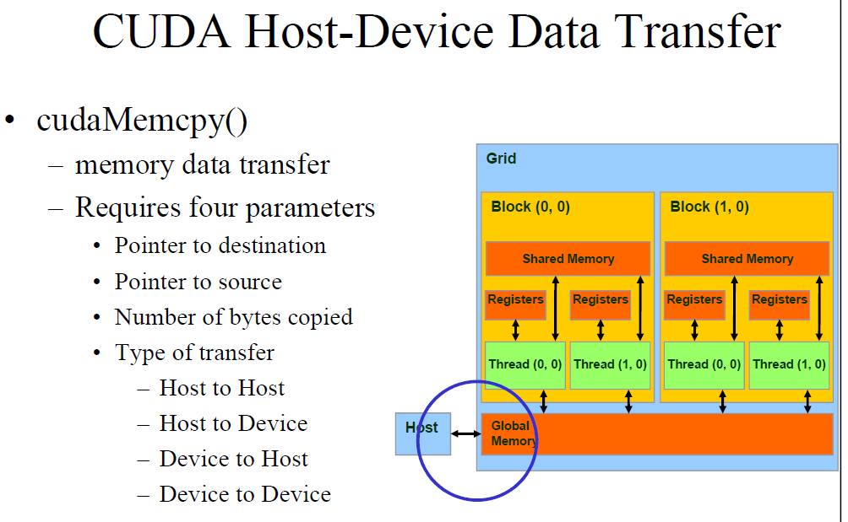

Slide 57
Syntax
cudaMemcpy(Md, M, size, cudaMemcpyHostToDevice);
cudaMemcpy(M, Md, size, cudaMemcpyDeviceToHost);
M is host memory and Md is device memory
cudaMemcpyHostToDevice and cudaMemcpyDeviceToHost are symbolic constants

Slide 58
CUDA GLOBAL MEMORY PROCESSING FLOW
First load data into CPU memory
Perform the following steps:
1. Allocate GPU memory – e.g, cudaMalloc()
2. Populate GPU memory with inputs from the host – e.g.,cudaMemcpy(…,
cudaMemcpyHostToDevice)
3. Execute a GPU kernel on those inputs - e.g., kernel<<<>>> (gpuVar)
4. Transfer outputs from the GPU back to the host - e.g., cudaMemcpy(..,
cudaMemcpyDeviceToHost)
5. Free GPU memory
Use the results on CPU
The host can access the device memory and transfer data to and from it, but not the other way round.
CUDA provides API functions to accomplish all these steps.

Slide 59
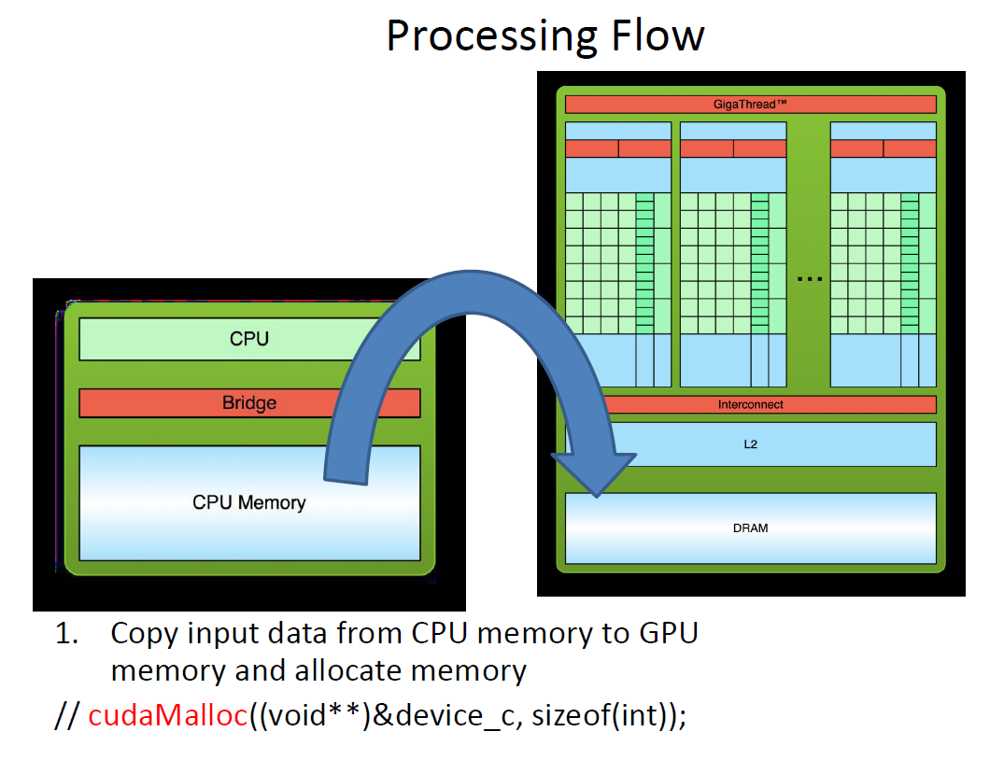

Slide 60
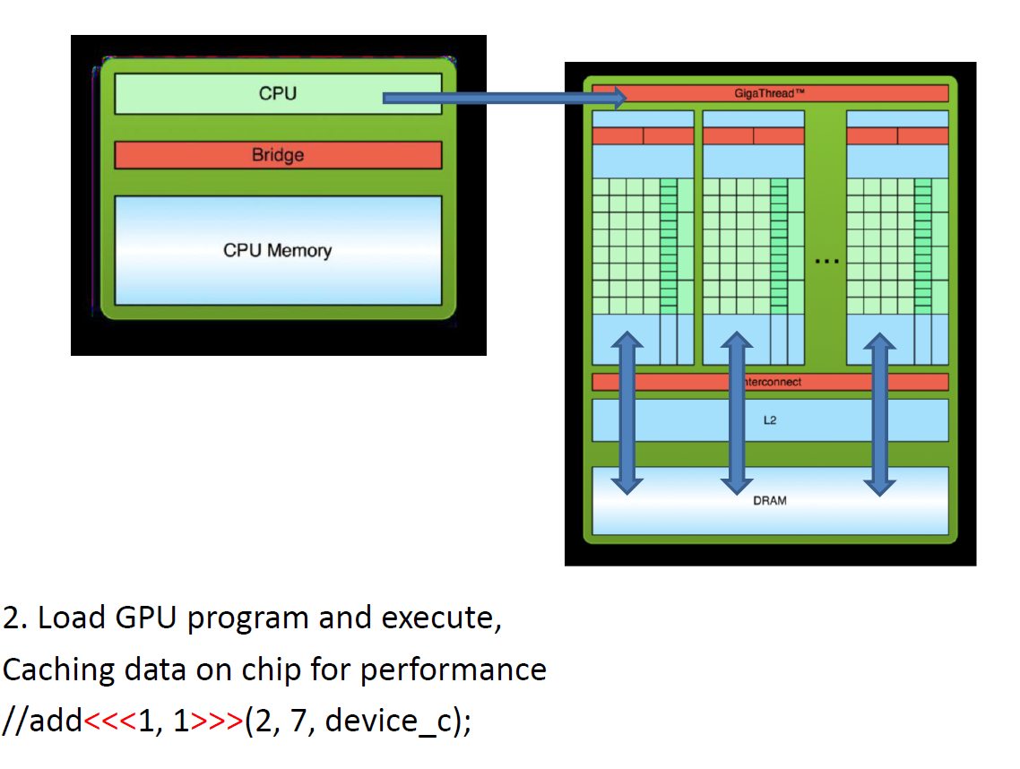

Slide 61
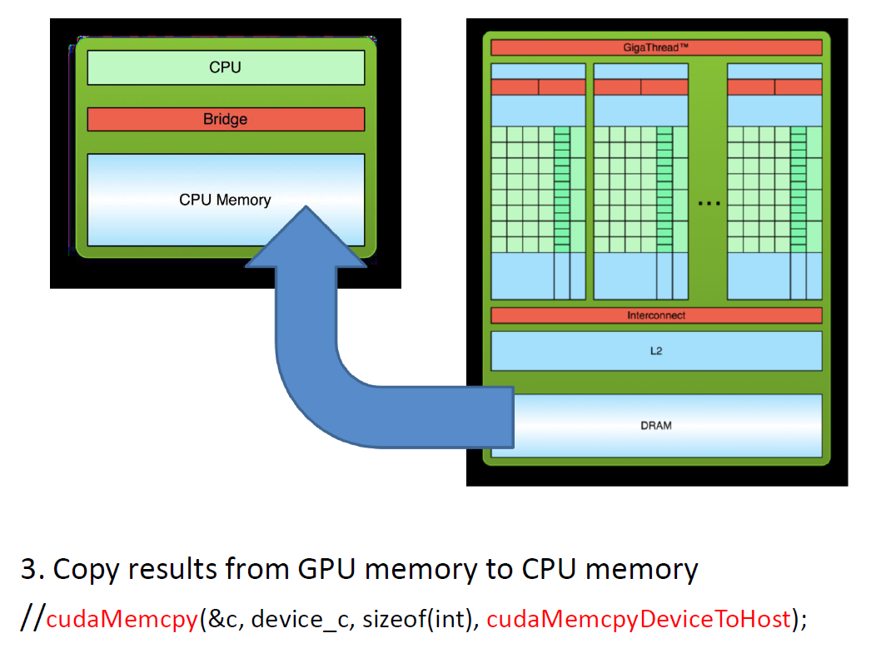

Slide 62
Addition of Two Numbers
#include <stdio.h>
#include <cuda_runtime.h>
// Kernel function to add two numbers
__global__ void Addition(int *a, int *b, int *c) {
*c = *a + *b;
}

Slide 63
int main() {
int a, b, c;
int *dev_a, *dev_b, *dev_c;
int size = sizeof(int);
// Allocate device memory
cudaMalloc((void**)&dev_a, size);
cudaMalloc((void**)&dev_b, size);
cudaMalloc((void**)&dev_c, size);
// Get input from user
printf("Enter two numbers: ");
scanf("%d %d", &a, &b);

Slide 64
// Copy data from host to device
cudaMemcpy(dev_a, &a, size, cudaMemcpyHostToDevice);
cudaMemcpy(dev_b, &b, size, cudaMemcpyHostToDevice);
// Launch kernel on the GPU with 1 block and 1 thread
Addition<<<1, 1>>>(dev_a, dev_b, dev_c);
// Copy result from device to host
cudaMemcpy(&c, dev_c, size, cudaMemcpyDeviceToHost);
// Free device memory
cudaFree(dev_a);
cudaFree(dev_b);
cudaFree(dev_c);
// Output the result
printf("Result: %d\n", c);
return 0; }

Slide 65
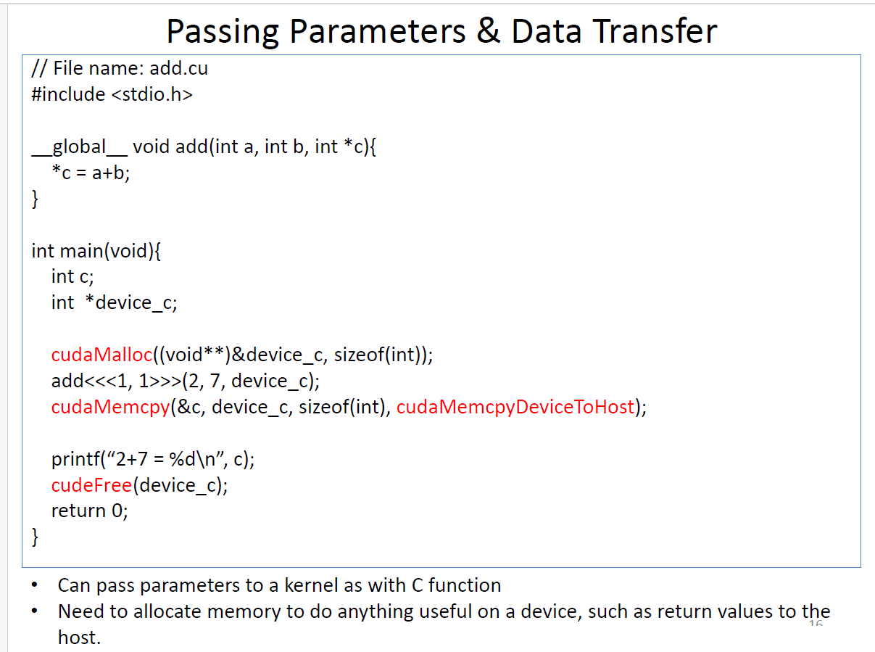

Slide 66
Explanation
The add() runs on the device, so device_c must point to the device memory
This is why we call cudaMalloc() to allocate memory on the device
The values 2 and 7 are passed by value from the host to the device. This means their values are directly copied into the kernel's execution context without requiring explicit memory allocation on the GPU.
We can access memory on a device through calls to cudaMemcpy() from host code.
After copying result to host from device, we can free the device memory using cudaFree()

Slide 67
Kernel Functions and Threading
How does a CUDA program work?
In CUDA, the kernel is executed with the aid of threads.
A kernel is a function that compiles to run on a device (GPU).
The thread is an abstract entity that represents the execution of the kernel.
Multi-threaded applications use many such threads that are running at the same time, to organize parallel computation.

Slide 68
Kernel Functions and Threading
While writing a CUDA program, the programmer has explicit control on the number of threads that he wants to launch.
These threads collectively form a three-dimensional grid (threads are packed into blocks, and blocks are packed into grids).
A group of threads is called a CUDA block.
CUDA blocks are grouped into a grid.
A kernel is executed as a grid of blocks of threads
Each thread is given a unique identifier, which can be used to identify what data it is to be acted upon.

Slide 69
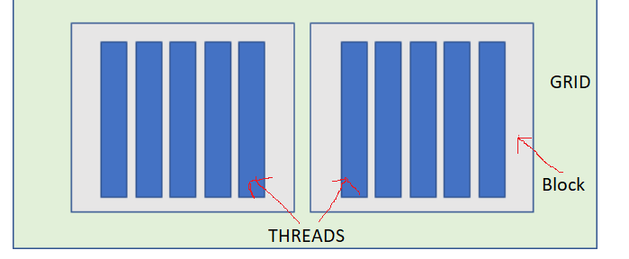
Three-Dimensional Grid - View

Slide 70
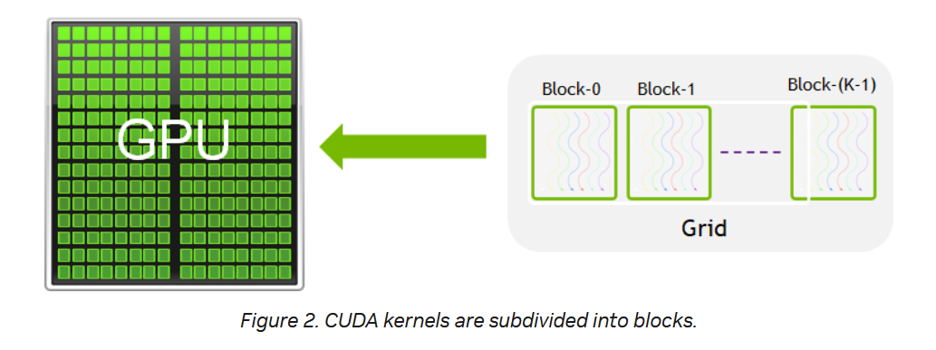

Slide 71
CUDA kernel and thread hierarchy
CUDA kernel is a function that gets executed on GPU as shown in figure 1 (next slide)
Every CUDA kernel starts with a __global__ declaration specifier.
Programmers provide a unique global ID to each thread by using built-in variables.
The parallel portion of your applications is executed K times in parallel by K different CUDA threads.
Every CUDA thread executes the same kernel logic (SIMT)
NVIDIA calls it Single-Instruction, Multiple-Thread (SIMT)
A kernel is executed once for every thread in every thread block configured when the kernel is launched.

Slide 72
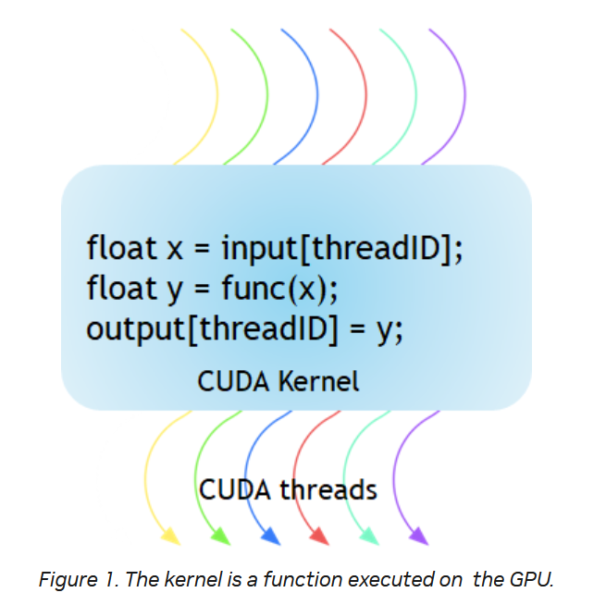

Slide 73
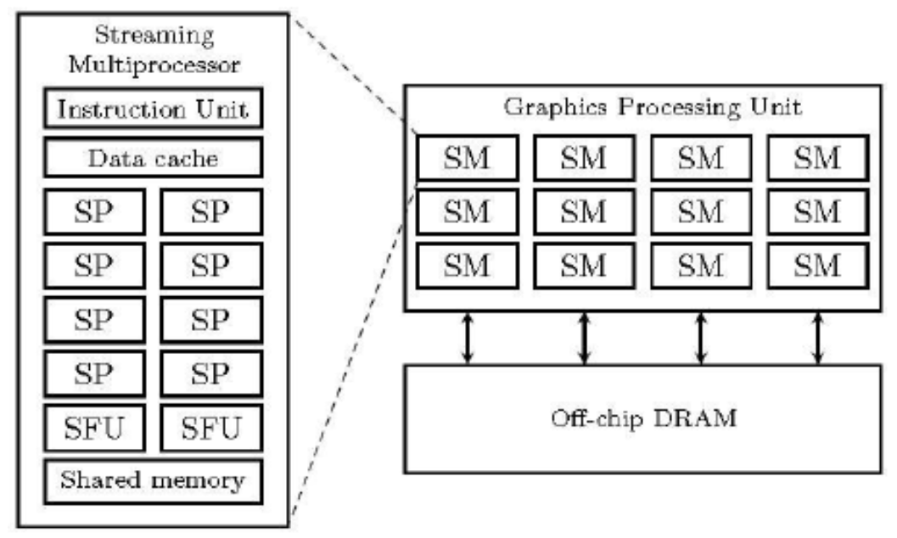
NVIDIA GPU Architecture

Slide 74
NVIDIA GPU Architecture
NVIDIA GPU consists of multiple Streaming Multiprocessors (SM).
Each SM contains multiple CUDA cores or Streaming Processors (SP) responsible for executing instructions.
Additionally, an SM includes Special Function Units (SFU), shared memory, registers, and other components necessary for executing and managing threads.
SFUs are specialized hardware units within SMs designed to execute specific instructions (eg: trigonometric functions, reciprocal calculations, etc) efficiently.
The number of SMs in a GPU determines its computational power and parallel processing capabilities.

Slide 75
NVIDIA GPU Architecture
Each CUDA block is executed by one Streaming Multiprocessor (SM) and cannot be migrated to other SMs in GPU (except during preemption, debugging, or CUDA dynamic parallelism).
One SM can run several concurrent CUDA blocks depending on the resources needed by CUDA blocks.
Figure in the next slide shows the kernel execution and mapping on hardware resources available in GPU.

Slide 76
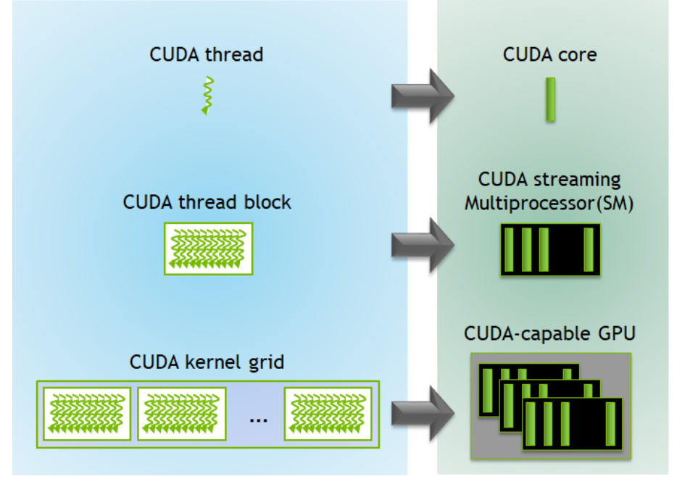
Kernel Execution on GPU

Slide 77
Data Parallel Execution Model

Slide 78
CUDA Thread Organization
Refers to how threads are organized and managed on a CUDA-enabled GPU (Graphics Processing Unit) during parallel computation.
All CUDA Threads are organized in Blocks.
We can organize our threads in 1,2 or 3-dimensional blocks.
Blocks are organized in Grids.
We can organize our blocks in 1,2 or 3-dimensional grids.

Slide 79
Main components of CUDA thread organization are:
Thread: The smallest unit of execution in CUDA. Each thread is responsible for performing a specific task or computation.
Block : A group of threads that execute the same kernel (function) and share data through shared memory. Threads within the same block can synchronize and communicate with each other. The number of threads per block is limited by the hardware specifications of the GPU.
Grid: A collection of blocks that execute the same kernel. Each block within a grid can execute independently and concurrently with other blocks. The number of blocks in a grid is determined by the application's requirements and the hardware limitations of the GPU.

Slide 80
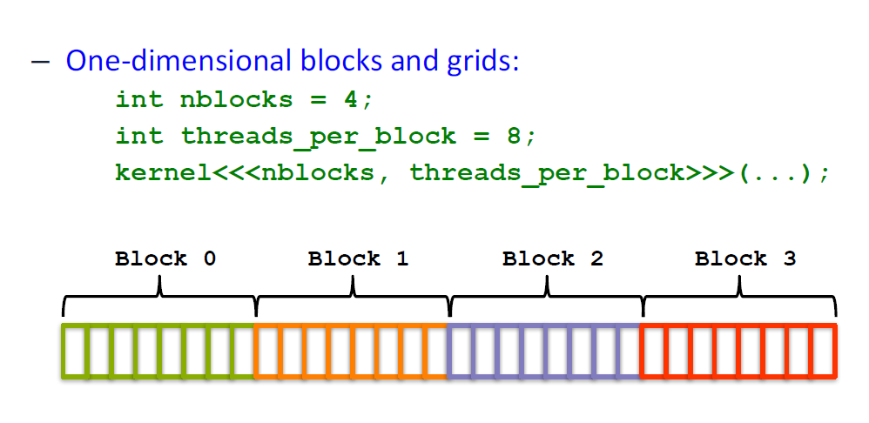
Threads can be configured in one-, two-, or three dimensional layouts.

Slide 81
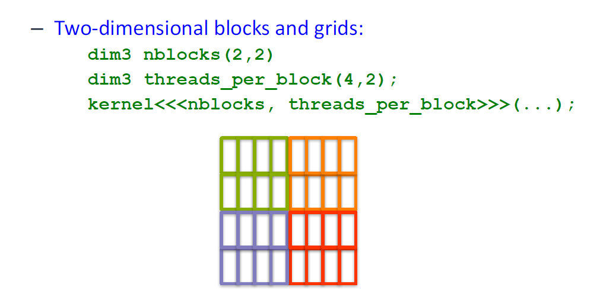

Slide 82
Explanation
When you define the number of threads per block using dim3, the first argument represents the number of threads in the x-dimension (columns), and the second argument represents the number of threads in the y-dimension (rows).
dim3 threadsPerBlock(4, 2);
Columns (x-dimension) = 4
Rows (y-dimension) = 2
Thus, one block contains 4 columns and 2 rows, totalling 4×2=8 threads per block.

Slide 83
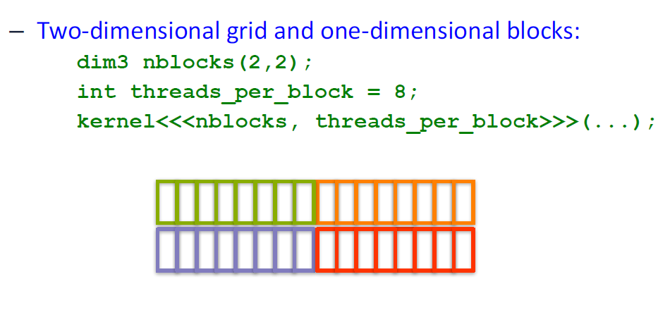

Slide 84
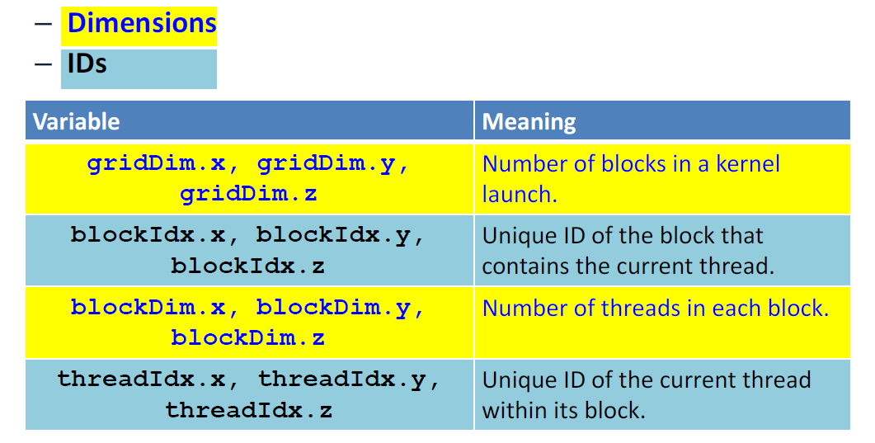
The number of blocks and threads per block is exposed through intrinsic thread coordinate variables:

Slide 85
Dimension and Indexing:
Grid Dimension: The number of blocks in each dimension of the grid. For example, a grid with dimensions (X, Y, Z) consists of X * Y * Z blocks.
Block Dimension: The number of threads in each dimension of a block. For example, a block with dimensions (X, Y, Z) consists of X * Y * Z threads.
Thread Indexing: CUDA provides built-in variables such as threadIdx, blockIdx, and blockDim to help threads identify their unique index within a block and grid. These variables are often used to compute memory access patterns and perform thread synchronization.
CUDA architecture limits the numbers of threads per block (1024 threads per block limit).

Slide 86
How to get Current thread number and the Total number of threads?
There are 4 variables each thread can access which contains information about the organization of threads and current thread. They are:
threadIdx : Id of the current thread.
blockIdx : Id of the current block.
blockDim : Number of threads in each dimension of the current block.
gridDim : Number of blocks in each dimension of the current grid.
All of these are dim3 structure. We can use dot notation to access variable x,y,z which contains the information of the corresponding dimension. Example: threadIdx.x

Slide 87
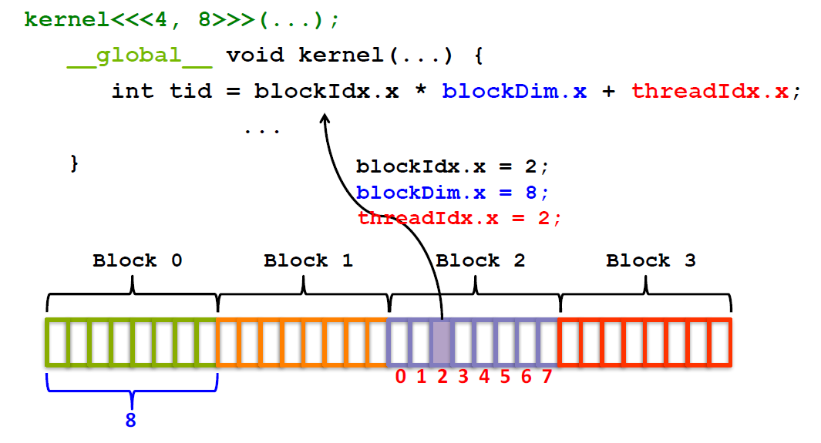
To calculate a globally unique ID for a thread inside a one-dimensional grid and one-dimensional block: tid=2×8+2=16+2=18

Slide 88
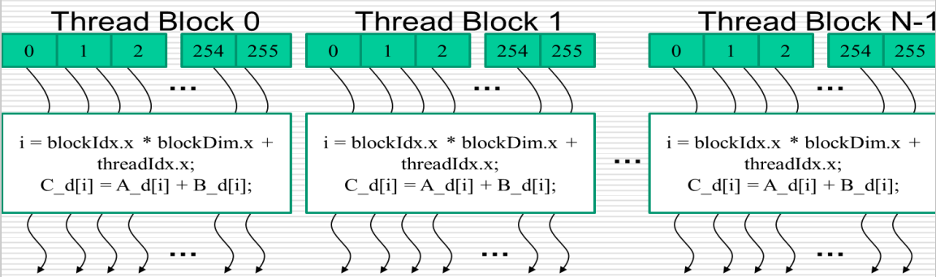
Thread Block Indexing

Slide 89
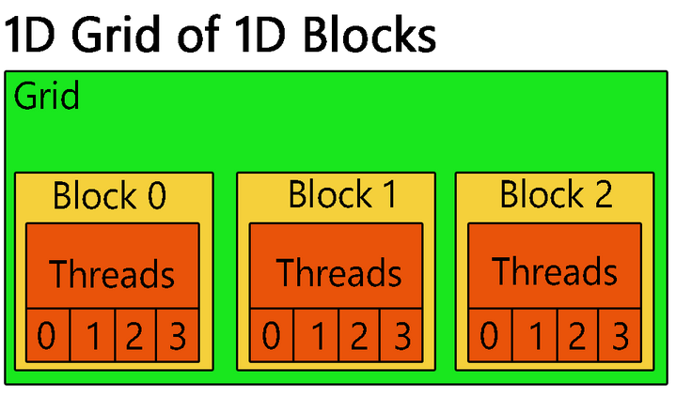
CUDA thread indexing for 1D grid of 1D blocks
In a 1D grid of 1D blocks in CUDA, the thread indexing follows a simple linear structure. Each thread is identified by a single index.
Let's say we have:
blockDim.x as the number of threads per block.
gridDim.x as the number of blocks in the grid.
Thread indexing formula will be :
threadIdx.x + blockDim.x * blockIdx.x
Here:
threadIdx.x represents the index of the thread within its block.
blockIdx.x represents the index of the block within the grid.
blockDim.x represents the number of threads per block.
For example, if we have a grid of 3 blocks (gridDim.x = 3) and each block contains 128 threads (blockDim.x = 128), then the thread indexing will range from 0 to 383 (3 blocks * 128 threads/block - 1).

Slide 90
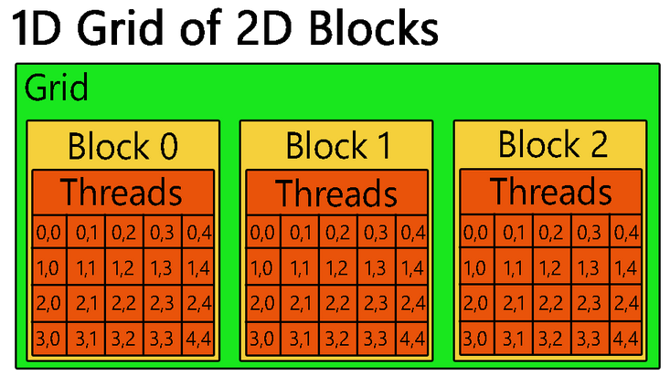
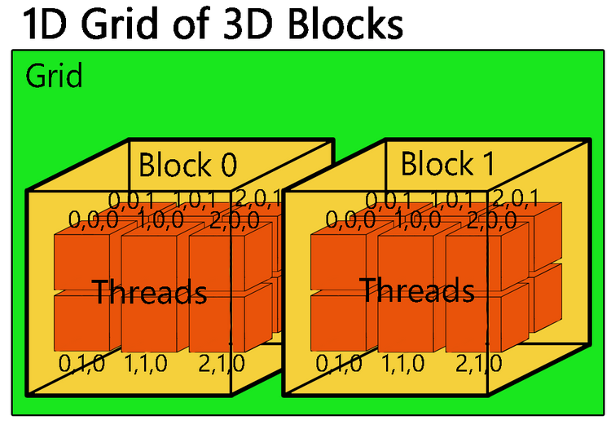
Multi-dimensional CUDA Thread

Slide 91
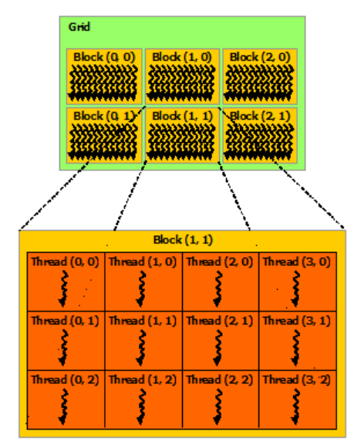
blockIdx and threadIdx: Detailed Explanation
Let's say the block dimensions are block(4, 3), for instance. This means there are 4 threads in the x dimension and 3 threads in the y dimension, resulting in a total of 4 * 3 = 12 threads in the block.
thread(0,0), thread(0,1), thread(0,2), etc., typically refers to the indices of threads within a block.
These indices represent the position of each thread within a two-dimensional block in CUDA.
For example:
thread(0,0) refers to the thread at index (0, 0) within the block.
thread(0,1) refers to the thread at index (0, 1) within the block.
thread(0,2) refers to the thread at index (0, 2) within the block.
and so on...

Slide 92
Example Code
This program calculates the sum of two arrays on the GPU and then transfers the result back to the host for printing.
#include <stdio.h>
// Kernel function to add two arrays element-wise
__global__ void addArrays(int *a, int *b, int *c, int size) {
int idx = blockIdx.x * blockDim.x + threadIdx.x;
if (idx < size) {
c[idx] = a[idx] + b[idx];
}
}

Slide 93
int main() {
const int size = 5;
int a[size] = {1, 2, 3, 4, 5};
int b[size] = {10, 20, 30, 40, 50};
int c[size]; // Result array
int *d_a, *d_b, *d_c; // Device arrays
// Allocate memory on the device
cudaMalloc((void**)&d_a, size * sizeof(int));
cudaMalloc((void**)&d_b, size * sizeof(int));
cudaMalloc((void**)&d_c, size * sizeof(int));
// Transfer data from host to device
cudaMemcpy(d_a, a, size * sizeof(int), cudaMemcpyHostToDevice);
cudaMemcpy(d_b, b, size * sizeof(int), cudaMemcpyHostToDevice);
// Define grid and block dimensions
int threadsPerBlock = 256;
int blocksPerGrid = (size + threadsPerBlock - 1) / threadsPerBlock;

Slide 94
// Launch kernel
addArrays<<<blocksPerGrid, threadsPerBlock>>>(d_a, d_b, d_c, size);
// Wait for kernel to finish
cudaDeviceSynchronize();
// Transfer result from device to host
cudaMemcpy(c, d_c, size * sizeof(int), cudaMemcpyDeviceToHost);
// Print the result
printf("Result:\n");
for (int i = 0; i < size; ++i) {
printf("%d + %d = %d\n", a[i], b[i], c[i]); }
// Free device memory
cudaFree(d_a);
cudaFree(d_b);
cudaFree(d_c);
return 0; }

Slide 95
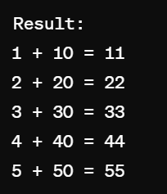
Output
Output shows the element-wise addition of the arrays a and b, stored in the array c, as calculated on the GPU. Each element of array c is the sum of the corresponding elements from arrays a and b.

Slide 96
Explanation
Define two arrays a and b on the host and initialize them with some values.
Allocate memory for arrays d_a, d_b, and d_c on the device using cudaMalloc.
Transfer data from the host arrays a and b to the corresponding device arrays d_a and d_b using cudaMemcpy.
Launch a kernel (addArrays) to add the arrays element-wise on the GPU.
Transfer the result from the device array d_c back to the host array c using cudaMemcpy.
Print the result.
Free allocated device memory using cudaFree.

Slide 97
Tiled Matrix Multiplication
Tiled Matrix Multiplication is a technique used to optimize matrix multiplication by dividing the input matrices into smaller submatrices (called tiles or blocks) and performing the multiplication on these tiles.
This approach is particularly useful for improving cache utilization, parallelism and scalability in both shared-memory and distributed – memory systems.

Slide 98
End of Module 4
(THANK YOU)

